Slide 1
CONTENT RECOMMENDATION SYSTEM FOR LAN
Final Year Project Presentation
Under the supervision of Mr. Ratnesh Srivastava
Department of Information Technology

Slide 2
Project Members
Garima Garg (39026)
Himanshu Punetha (39029)
Kamal Kishor Joshi (39030)
Manzil Prakash (39036)

Slide 3
CONTENTS
Introduction
Purpose of the Project
Modules
Issues
Tools & Technologies Used
Use Case Diagram
Implementation
Logging
Java Docs
Problem faced in solving the problem
Future work to be done
References
Conclusion

Slide 4
INTRODUCTION
Content Recommendation systems expose the user to a huge collection of items.
Such systems typically provide the user with a list of recommended items they might prefer, or predict how much they might prefer each item.
These systems help users to decide on appropriate items, and ease the task to find preferred items in the collection.
They share in common a means for creating a profile of the user that describes the types of items the user likes, and a means of comparing items to the user profile to determine what to recommend.

Slide 5
PURPOSE OF PROJECT
  The goal of this project is to describe the content recommendation systems for LAN.
  Systems that recommend an item to a user based upon a description of the item and a profile of the user’s interests.
  System involves collection of user preferences for the available content and to learn user behaviour from that.
  To minimize user’s efforts to provide feedback and simultaneously to maximize the user’s satisfaction by displaying appropriate content at the right time.
  The system provides indexed searching.

Slide 6
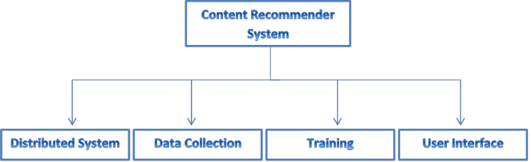
MODULES
It also contains three smaller modules :
Searching & Sorting
Web Server
File Info Database

Slide 7
ISSUES
There are various problems which are specific to a particular module ,
Time efficiency for retrieval of shared files in LAN is very crucial, so making it efficient is one major issue specific to searching .
To retrieve other systems information after pinging them through a system and to make the retrieval of information efficient is a problem specific to Distributed System.
To maintain the scalability of the system on increasing the number of resources is specific to Distributed System.
Distribution of data among computers and Error handling i.e., if network fails , then data to be collected may be lost etc. are specific to Data Collection Module

Slide 8
Hardware Specification
System with minimum 512 MB RAM
Software Specification
Eclipse Ide
Notepad++
Firefox
VLC plugin
JDK 1.5
JCIFS library

Slide 9
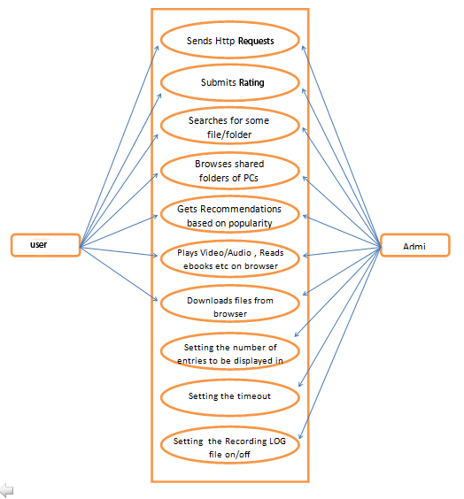
USE CASE DIAGRAM

Slide 10
IMPLEMENTATION
In User Interface Model
A user interface is the system by which people (users) interact with a computer .
It provide a means of allowing the users to manipulate a system and allowing the system to indicate the effects of the users' manipulation.
We have chosen to build a web based interface as web based interface offers much more flexibility as compared to an application based interface.
It also provides the functionality of downloading the files and Searching.
For example, web based interface offers adding plug-ins for video players, music players etc and through web based interface one person can access his account from other’s computer. It will show content like e-Books, videos, music etc in the browser itself.

Slide 11
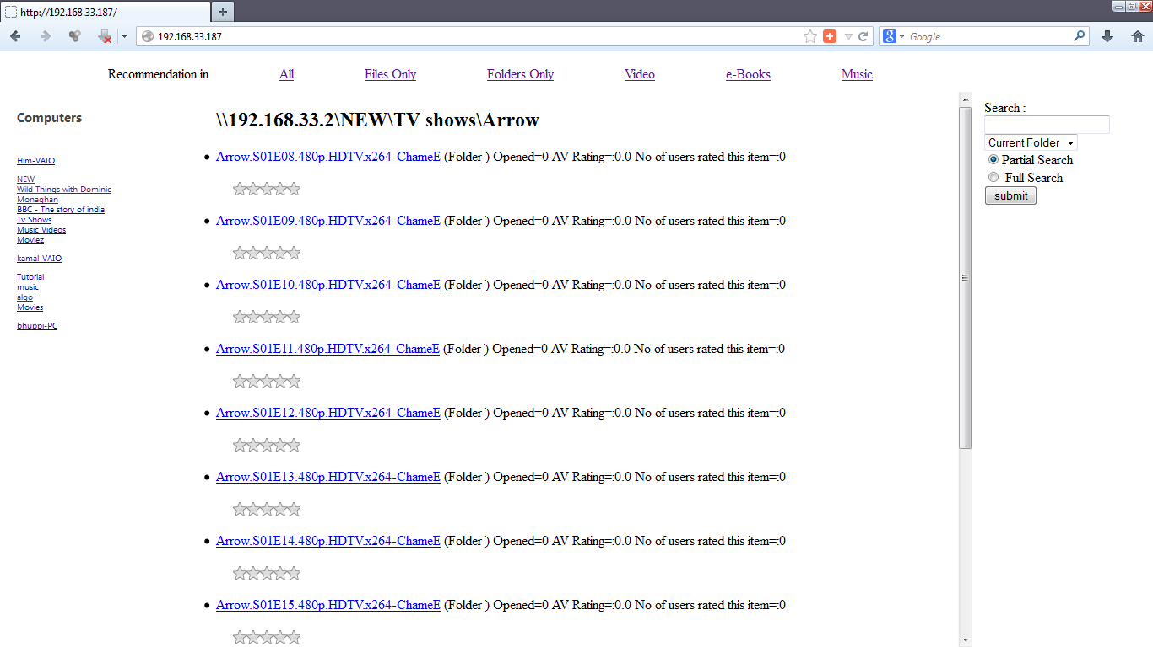
PATH BROWSING

Slide 12
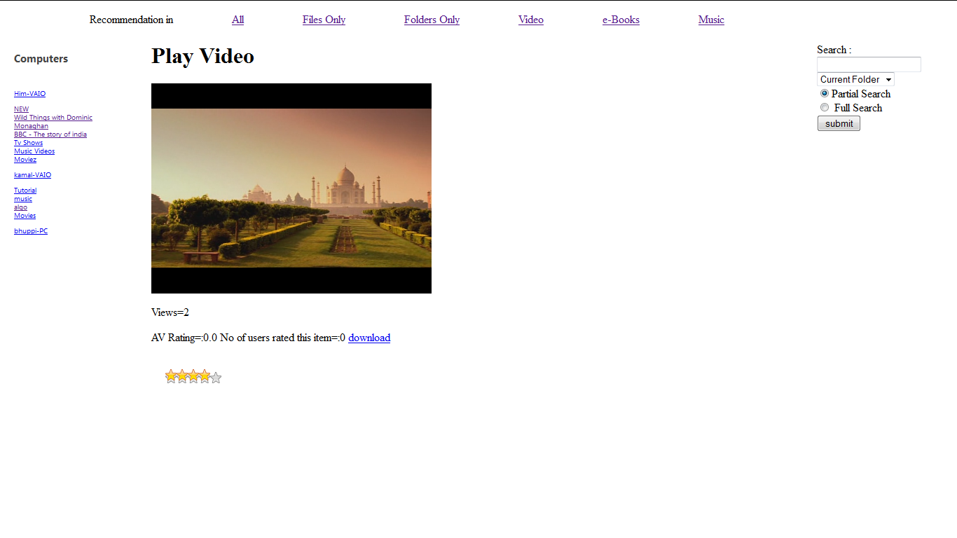

Slide 13
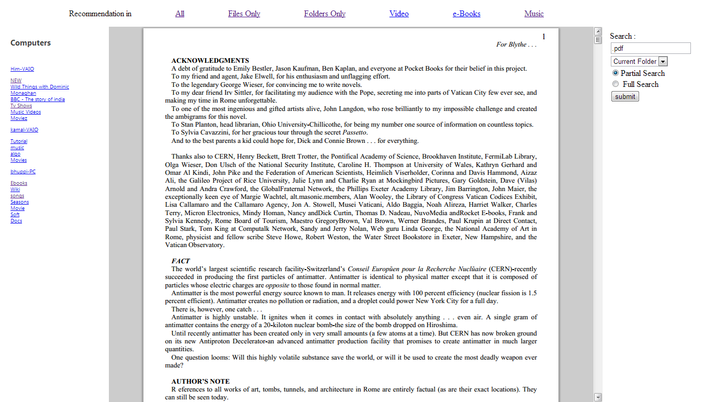

Slide 14
In distributed system model
Ping mechanism has been developed which will be helpful to determine the online PCs.
Through the ping mechanism the source PC (which Broadcasts the Ping Request) will get the resource information of the other connected PCs.
Two types of Ping UDP packets have been used –
- Ping Request Packet
- Ping Reply Packet
The Ping Reply Packet will contain following information
-- IP address, Latency, Authentication (byte array),Total memory, free memory , Processer and system information.

Slide 15
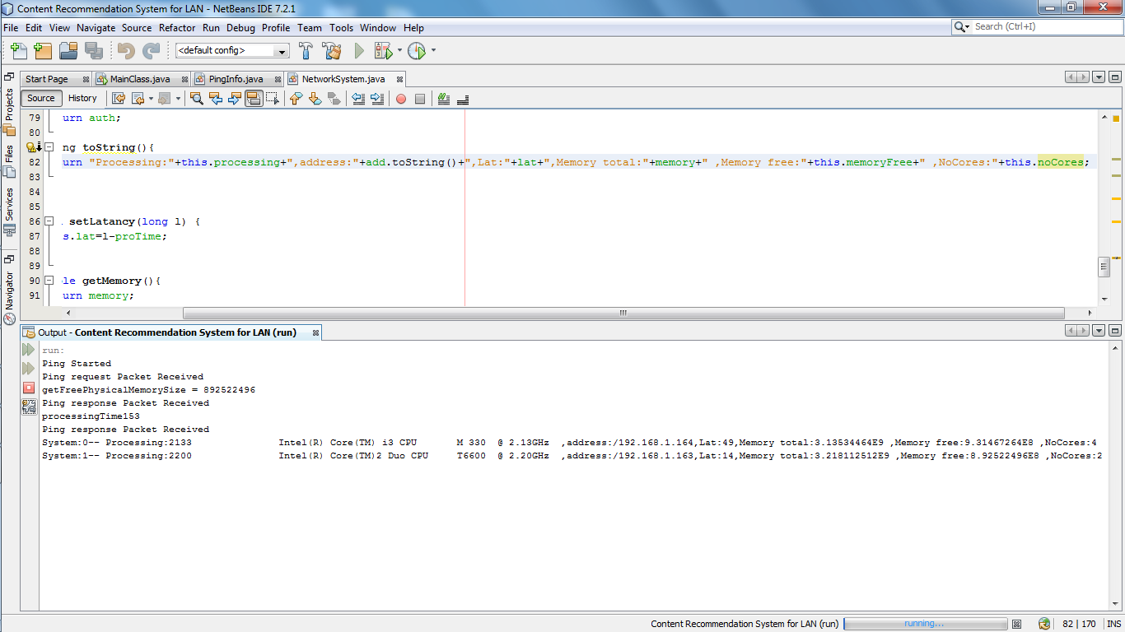

Slide 16
Output for ping in two systems is as follows –
Ping Started
Ping request Packet Received
getFreePhysicalMemorySize = 892522496
Ping response Packet Received
processingTime153
Ping response Packet Received
System:0-- Processing:2133 Intel(R) Core(TM) i3 CPU M 330 @ 2.13GHz ,address:/192.168.1.164,Lat:49,Memory total:3.13534464E9 ,Memory free:9.31467264E8 ,NoCores:4
System:1-- Processing:2200 Intel(R) Core(TM)2 Duo CPU T6600 @ 2.20GHz ,address:/192.168.1.163,Lat:14,Memory total:3.218112512E9 ,Memory free:8.92522496E8 ,NoCores:2
Ping request Packet Received
getFreePhysicalMemorySize = 991379456
processingTime623

Slide 17
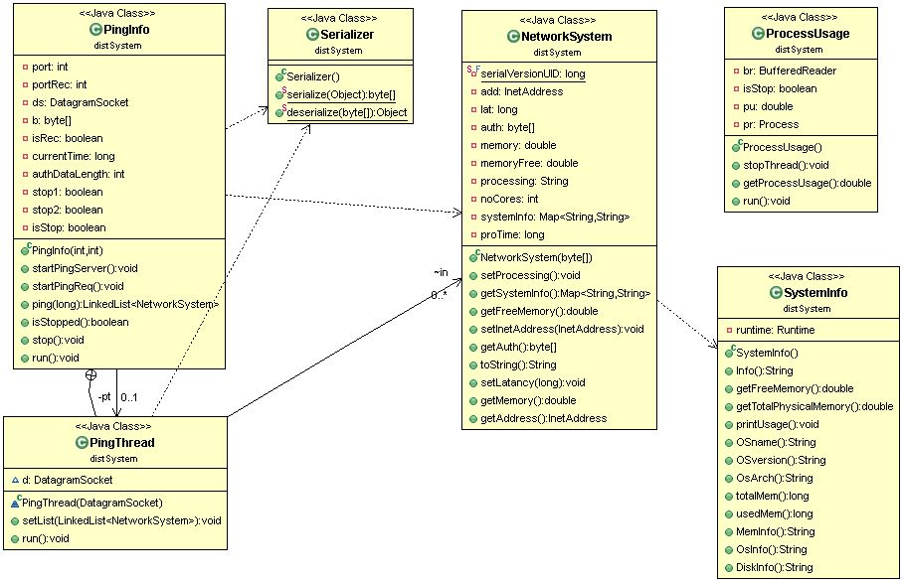
Class Diagram of Distributed System

Slide 18
In searching
As system is accessing the shared files in LAN so a library for SMB (Server Message Block) protocol is required. For this jcifs (http://jcifs.samba.org) library is used.
Depth first search algorithm for searching.
The search results are sorted according to their popularity/average ratings.
Two types of searching are available to users;
--user can either search for a file in the currently opened folder or can search for the file in all the computers,
--user can also perform a partial search which searches for the search term in the filename anywhere or a full search which completely matches the search term with the file name

Slide 19
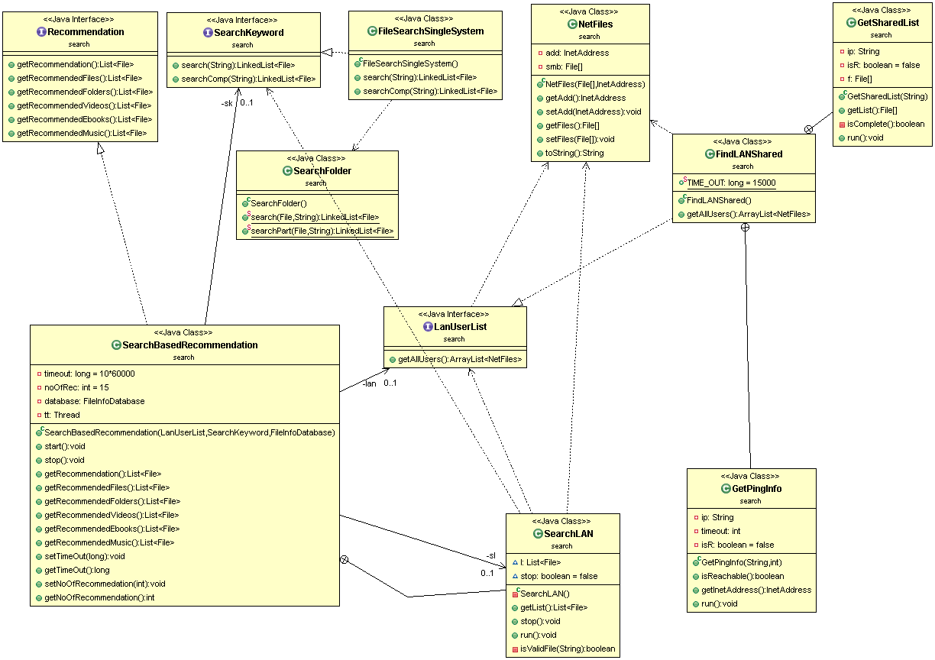
Class Diagram of Search Package

Slide 20
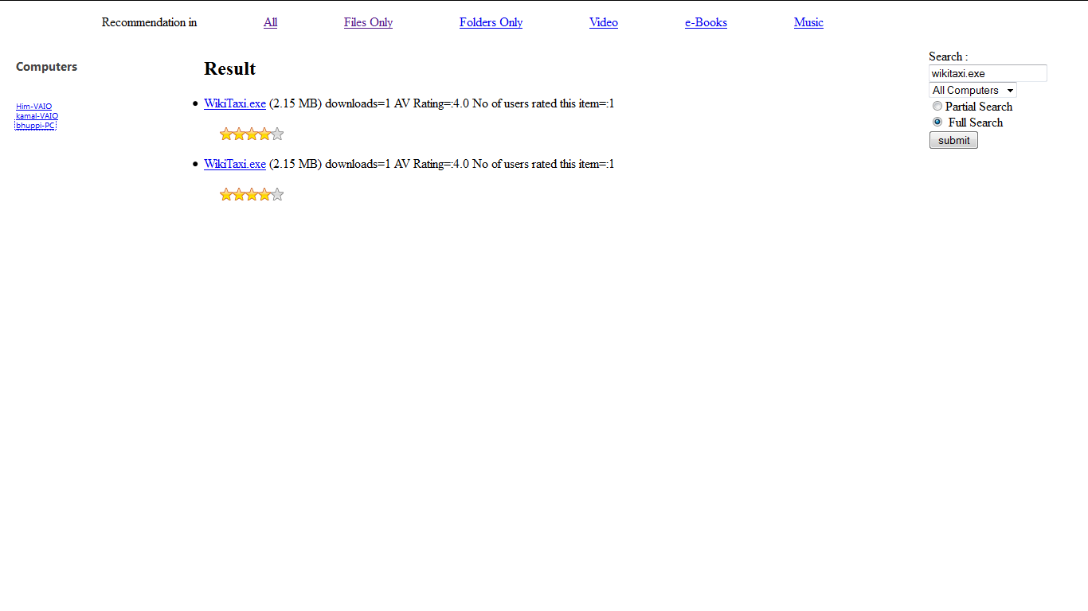
Full Search

Slide 21
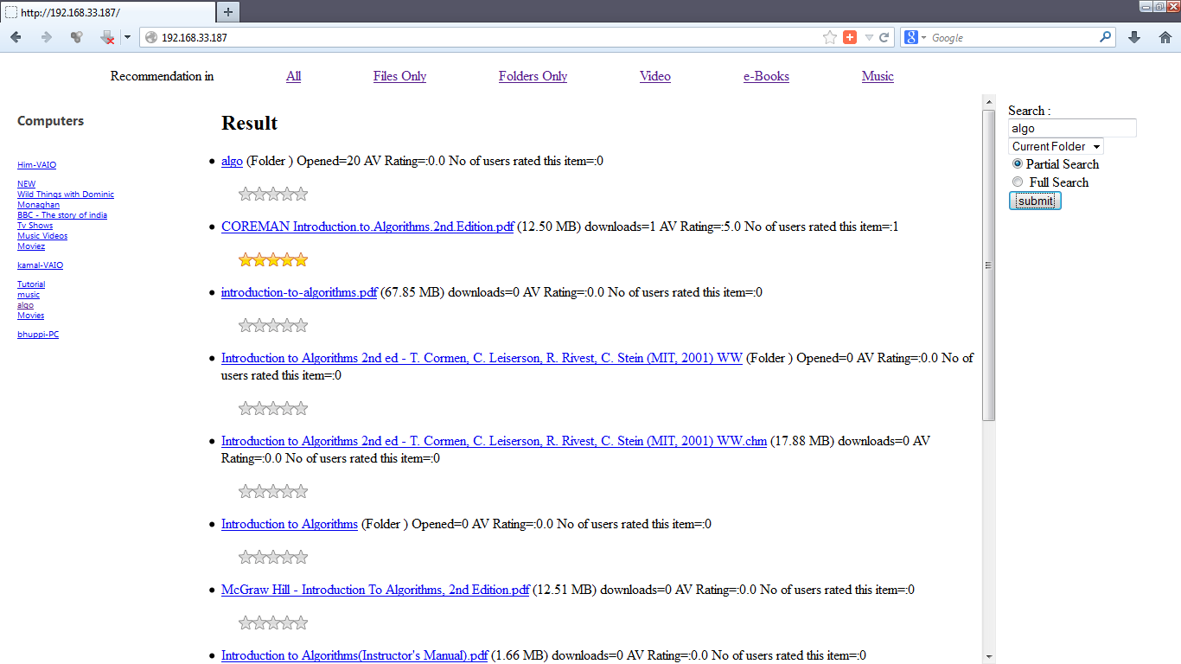
Partial Search

Slide 22
Sorting
For sorting the list of files and folders, four parameters are used –
- Number of times(n) file is downloaded / Number of times folder is opened .
- Rating(r) given by the users in a 1-5 scale (zero if not rated).
- Average rating(a) amongst all users.
-Number of users (u)who rate the file/folder.
All these features are given equal importance , so to compare two files following formula is used :-
Value = 0.25*(n+r+a+u)
The file having higher value is appears higher in the sorted results.

Slide 23
RECOMMENDATION
System provides general recommendation on the basis of the computers online in the network. It provides six types of recommendation:-
- Recommendation of all files and folders.
- Recommendation of files only.
- Recommendation of folders only.
- Recommendation of Videos
- Recommendation of e-Books
- Recommendation of Music.

Slide 24
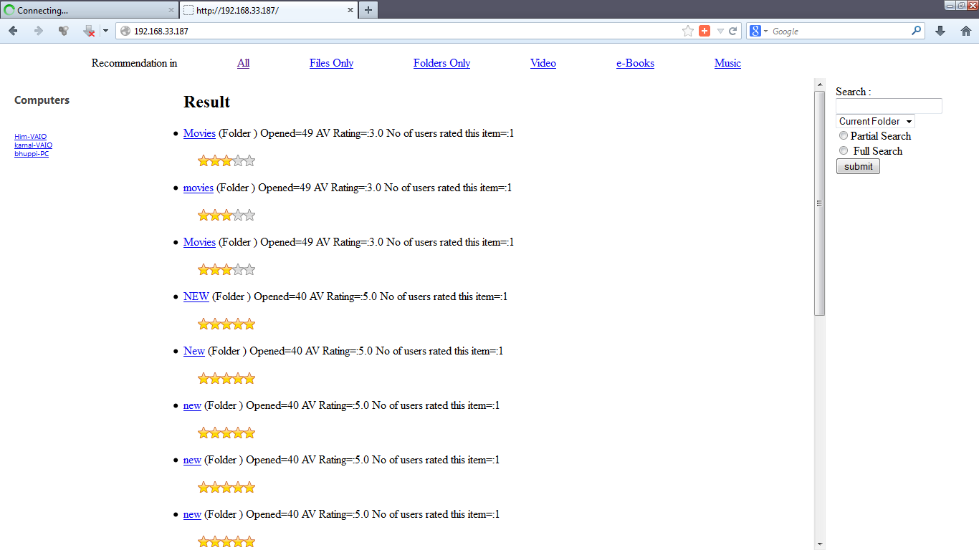
Recommedation of all files and folders

Slide 25
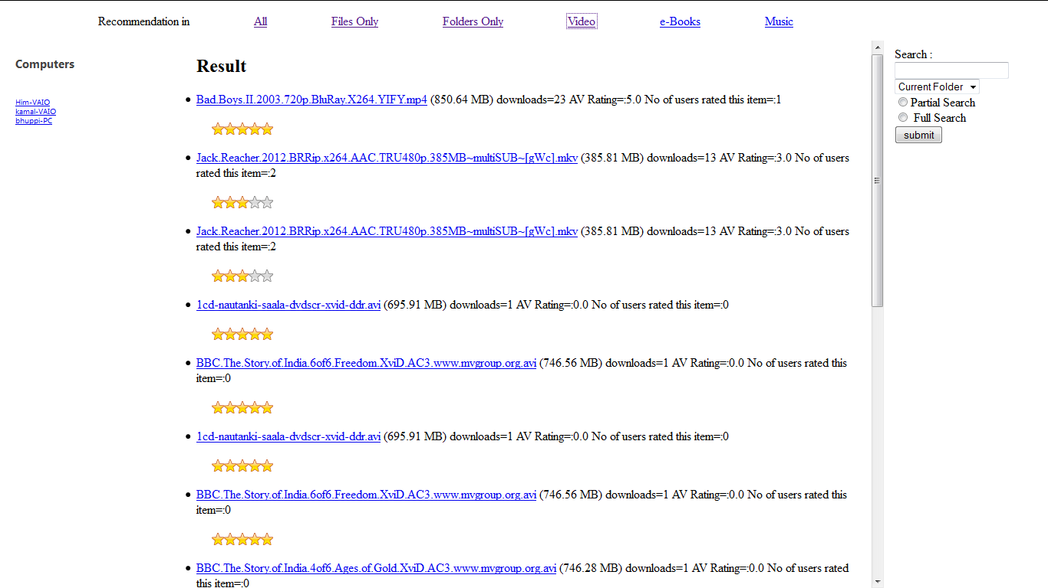
Recommendation of videos

Slide 26
File Information Database
To identify a file , a key is used which consists of its (name, size). It is assumed that (name, size) composite is different for each file.
If these two are same for two files then they are considered same by the system. For folders only name attribute defines the key.
A hashmap / hash table is used to map the key for a file with the information contained in that file.
To differentiate between users , their computer’s MAC addresses are used. So MAC address is used as a key for each user and A hashmap / hash table is maintained for mapping MAC address with the ratings submitted by that user.
After a particular time-out the settings (rating database) are saved .

Slide 27
Web Server
Web Server is built from scratch in the system to reduce the complexity, processing power and time.
The web server will process all the requests and provide appropriate response.
It is used for putting the dynamic html code in the html files.
For example – in getting the list of all the connected Pcs and their shared folders and then showing it in html file.

Slide 28
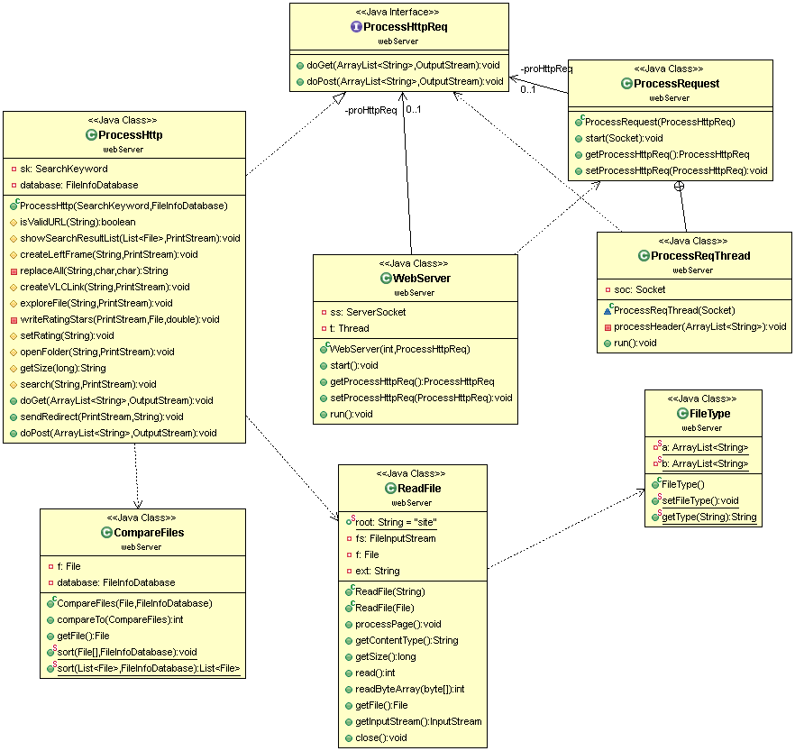
Class Diagram of Web Server

Slide 29
LOGGING
All the activities like requests received, number of computers connected at a moment, the destination of UDP packets etc. are logged in a file
So that if some problem occurs then state of the system can be resumed or the system can take actions according to the log.
The time is noted at each log entry.

Slide 30
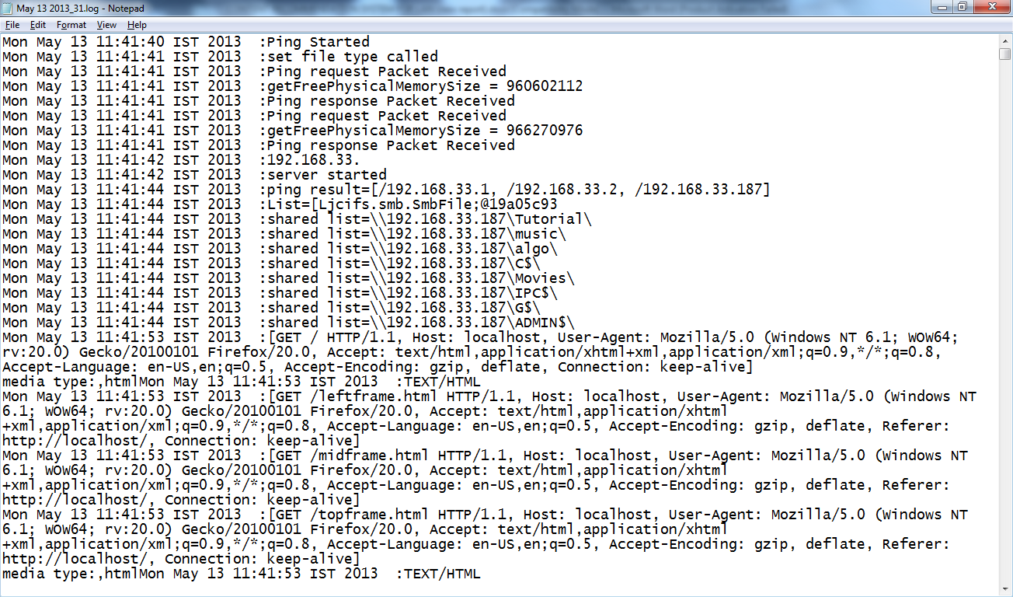

Slide 31
JAVA DOCS
Javadoc is a documentation generator from Oracle Corporation for generating API documentation in HTML format from Java source code.
The HTML format is used to add the convenience of being able to hyperlink related documents together.
Java Docs for our project has the outline as given in following figure.

Slide 32
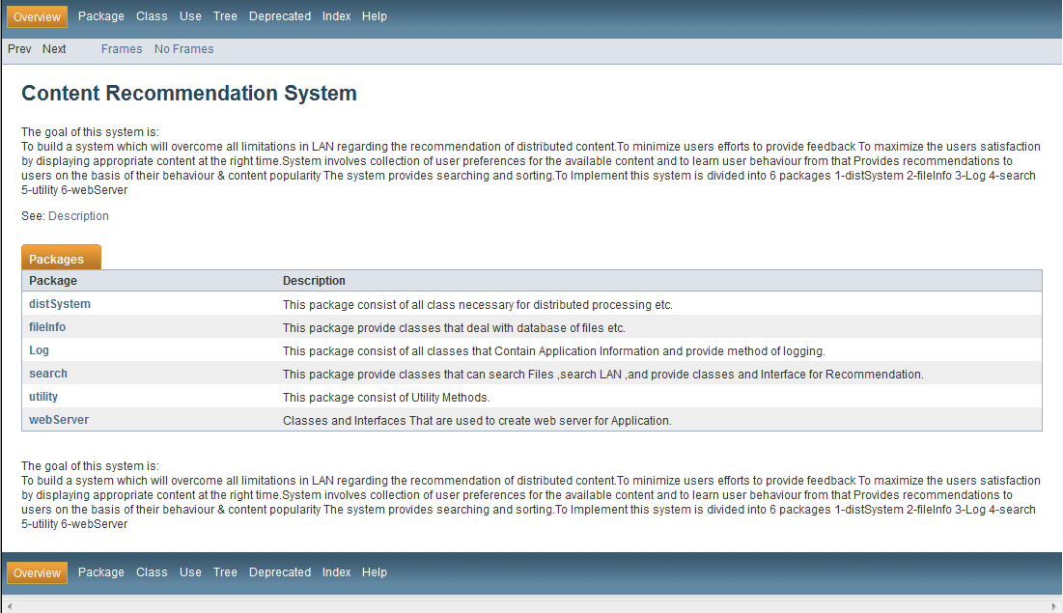

Slide 33
PROBLEMS FACED
Time efficiency for retrieval of shared files in LAN is very crucial, so making it efficient was one major issue we faced.
To retrieve other systems information after pinging them through a system and to make the retrieval of information efficient was also a problem faced by us.
To maintain the scalability of the system on increasing the number of resources

Slide 34
FUTURE WORK TO BE DONE
This project can be enhanced in following ways
The distributed system can be extended so that processing can be shared with other computers.
User Interface can be improved to be more user friendly and attractive looking.
Searching can be made more efficient by applying it in the distributed system.
The Recommendation can be improved by including behavior learning.

Slide 35
REFERENCES
Andrews, Gregory R. (2000), Foundations of Multithreaded, Parallel, and Distributed Programming, Addison–Wesley, ISBN 0-201-35752-6.
Arora, Sanjeev; Barak, Boaz (2009), Computational Complexity – A Modern Approach, Cambridge, ISBN 978-0-521-42426-4.
Cormen, Thomas H.; Leiserson, Charles E.; Rivest, Ronald L. (1990), Introduction to Algorithms (1st ed.), MIT Press, ISBN 0-262-03141-8.
Documentation of jcifs API (http://jcifs.samba.org) - http://stderr.org/doc/libjcifs-java-doc/api/overview-summary.html
Russell, Stuart J.; Norvig, Peter (2003), Artificial Intelligence: A Modern Approach (2nd ed.), Upper Saddle River, New Jersey: Prentice Hall, ISBN 0-13-790395-2

Slide 36
CONCLUSION
With the development of information access, recommender systems have become a popular technique to prune large information spaces so that users are directed toward those items that best meet their needs and preferences. The user can use Recommender System to see the recommended movies, music when he is confused about what to watch/listen. User can search for files/folders in all the computers in the network and find sorted results easily and in faster manner. It can be used for educational purposes – to see recommended books , lectures etc. It can be used for Entertainment purposes i.e to watch movies , music videos etc. User can browse the shared files/folders of other computers Further, the correct application of the semantic content information obtained from user profiles does enhance the effectiveness of collaborative recommendation.

Slide 37
Thank you

